Slide 1
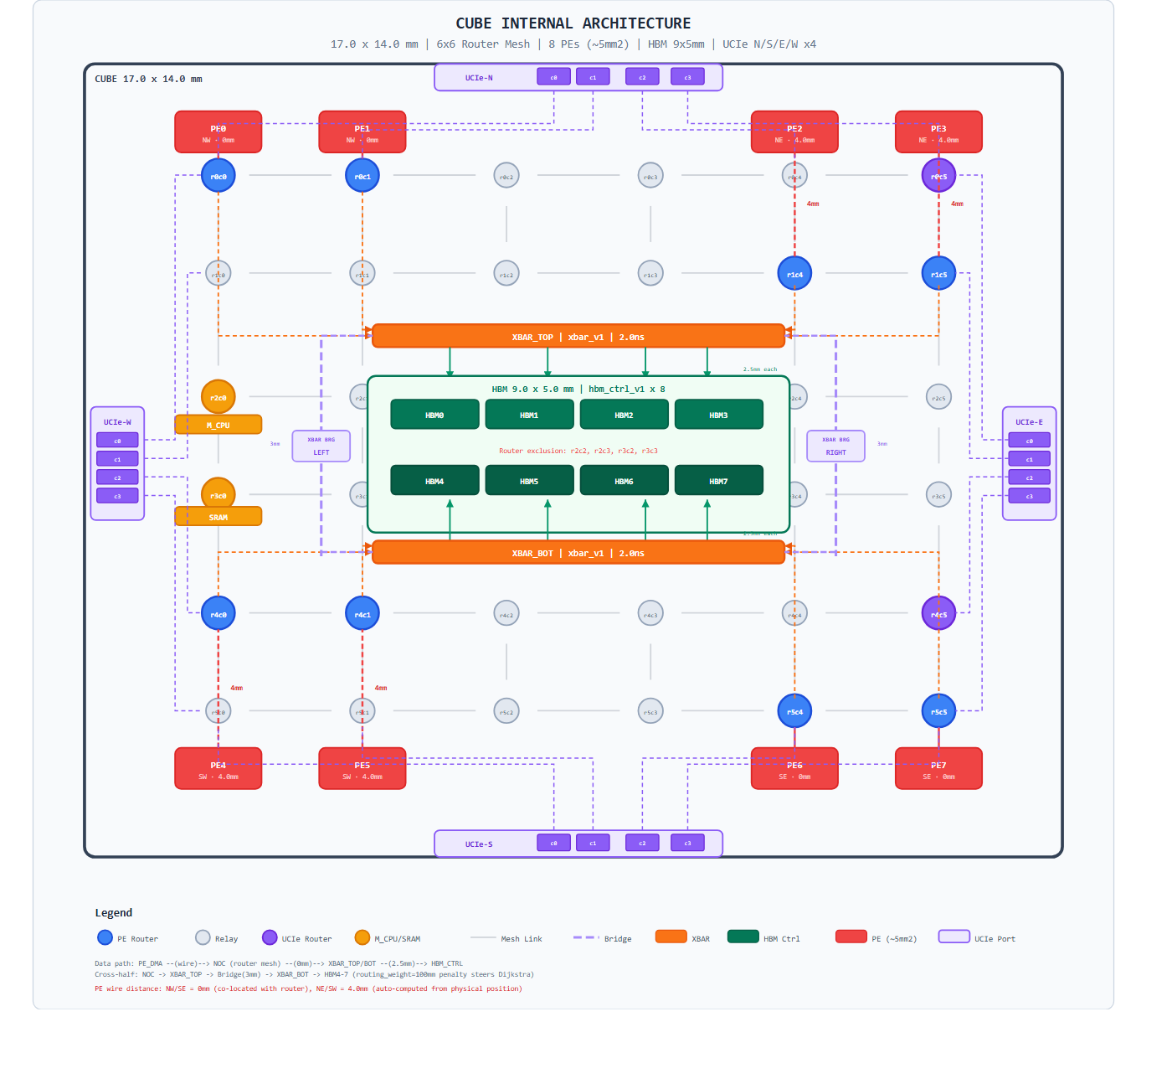
1. CUBE Architecture: NOC Router Mesh + PE Connectivity
• Each CUBE holds an 8-PE NOC mesh wired through routers (R0..R7)
• Every PE has IO_CPU, M_CPU, PE_CPU + IPCQ engine + DMA engine
• Inter-cube traffic exits via UCIe/UAL ports; SIPs stitch into ring/torus/mesh
• Foundation for every latency, IPCQ, and allreduce experiment that follows
1 / 5

Slide 2
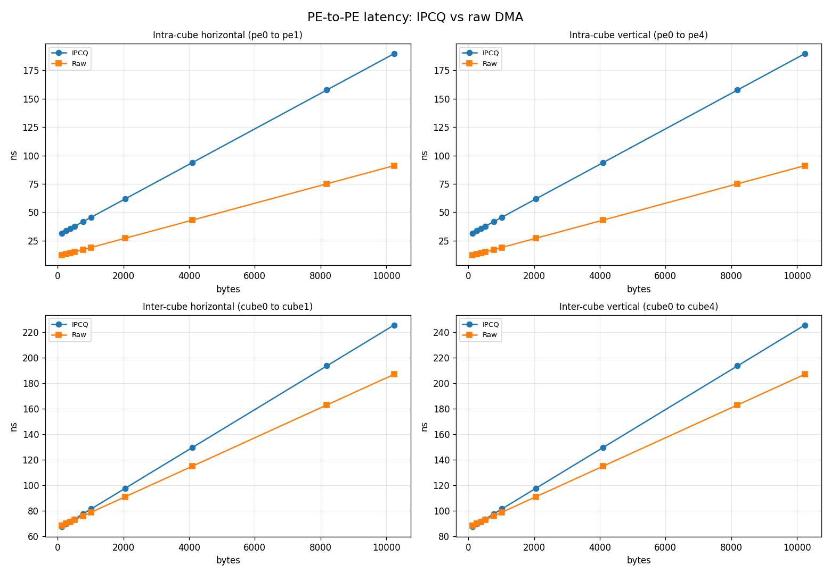
2. Model Correctness: DMA vs P2P Latency Sweep
• Sweeps payload size across PE-to-PE paths and compares to DMA
• Confirms the simulator reproduces the expected DMA/P2P crossover
• Acts as the per-hop ground truth that feeds collective-level models
2 / 5

Slide 3
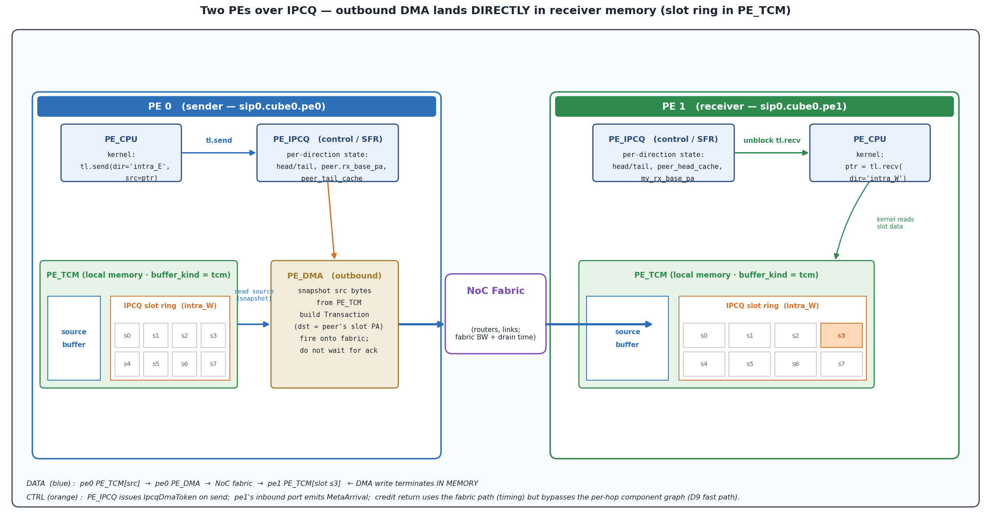
3. IPCQ: How Two PEs Communicate (DMA + Slot Memory)
• Sender pushes payload through PE_DMA → fabric → receiver IPCQ slot
• Slot memory (TCM/SRAM/HBM) charges a write on arrival, a read on consume
• Credit return rides the fabric path back (16 B packet, no slot-IO)
• This is the building block the multi-device allreduce composes
3 / 5

Slide 4
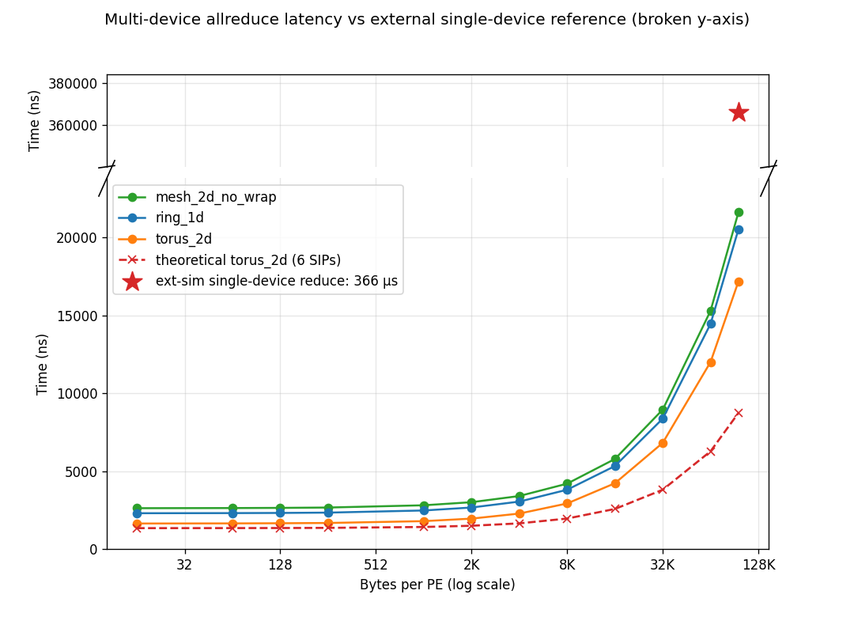
4. 6-Device Allreduce: Model vs Theoretical vs External Simulator
• Three SIP topologies (ring / torus / mesh) swept 16 B → 96 KB per PE
• Dashed red curve: hand-derived theoretical model for torus_2d (6 SIPs)
• Top panel (broken y-axis): single-device reduce on ext-sim ≈ 366 µs
• Our 6-device collective lands at ~17–22 µs — ~17× faster than ext-sim baseline
4 / 5

Slide 5
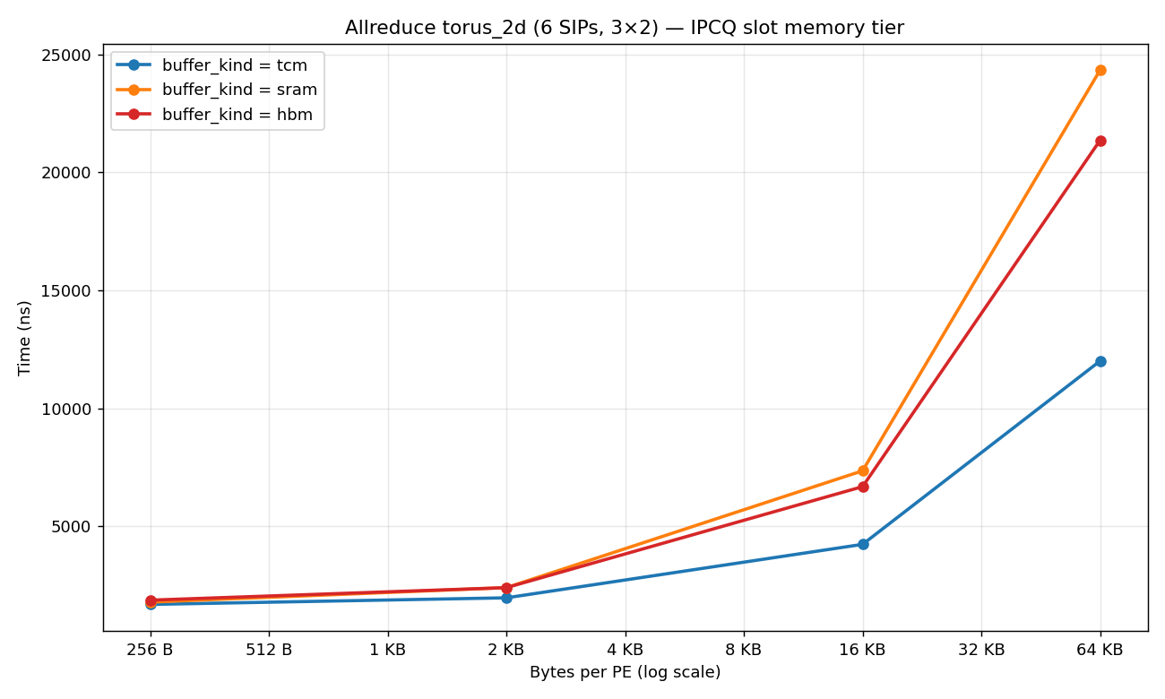
5. IPCQ Slot Memory: TCM vs SRAM vs HBM
• Same allreduce with slot memory swapped: TCM (per-PE local) / SRAM / HBM (cube-shared, behind router link)
• Cost = NoC drain + slot-IO + PE↔bank hop; only TCM skips the bank hop
• Topology link BWs set the order: SRAM bank link 128 GB/s is the narrowest in the system, HBM 256 GB/s
• At 64 KB / PE: TCM 12.0 µs < HBM 21.4 µs < SRAM 24.3 µs — SRAM is slowest because of its narrow bank link
5 / 5

