Slide 1
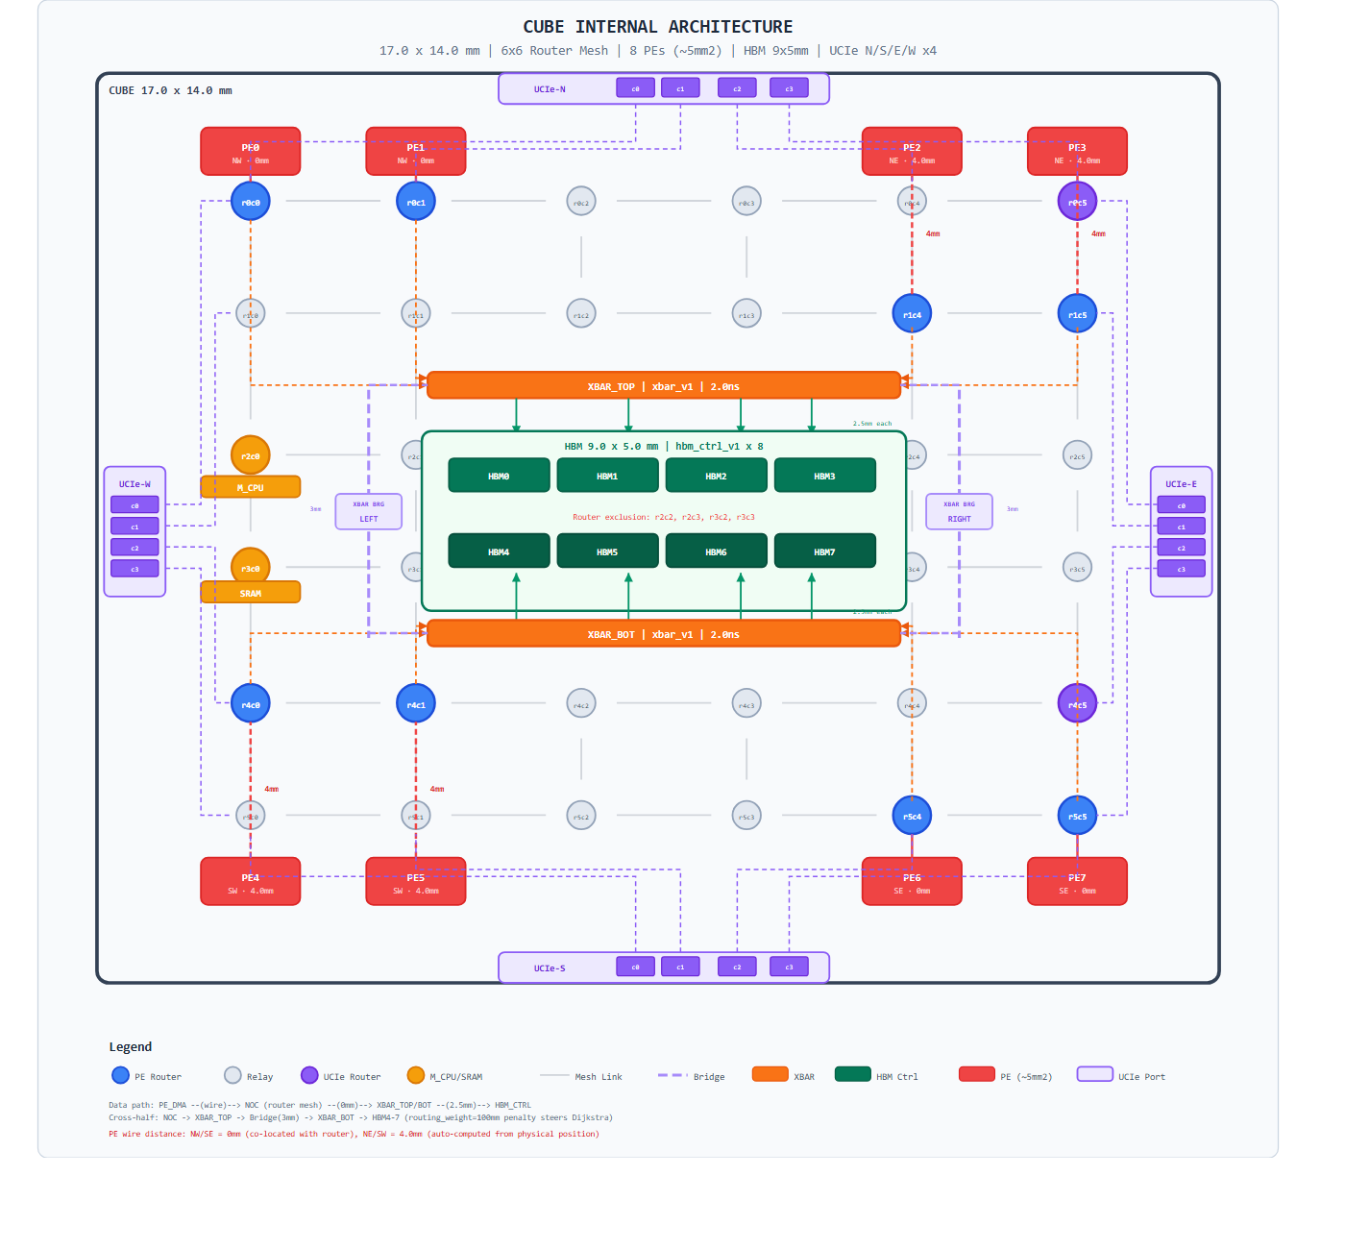
1. CUBE Architecture: NOC Router Mesh + PE Connectivity
• Each CUBE holds an 8-PE NOC mesh wired through routers (R0..R7)
• Every PE has IO_CPU, M_CPU, PE_CPU + IPCQ engine + DMA engine
• Inter-cube traffic exits via UCIe/UAL ports; SIPs stitch into ring/torus/mesh
• Foundation for every latency, IPCQ, and allreduce experiment that follows
1 / 17

Slide 2
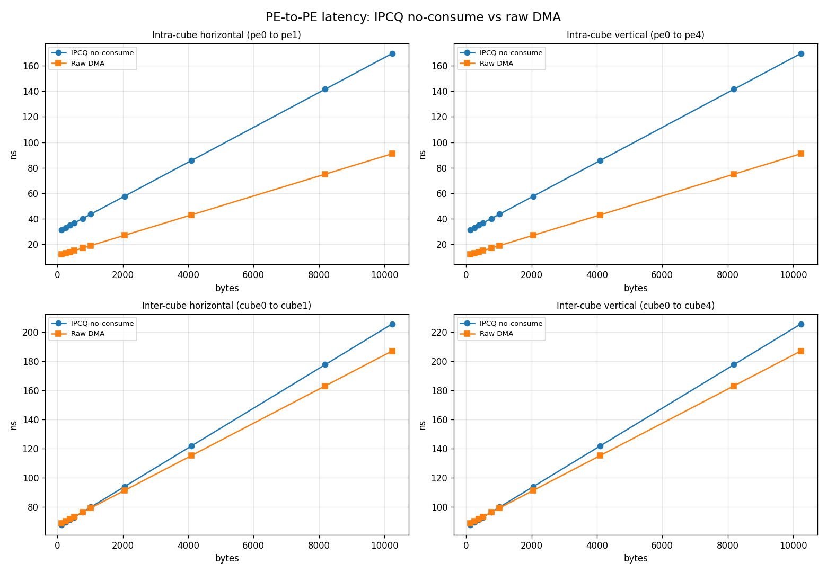
2. Model Correctness: DMA vs P2P Latency Sweep
• Sweeps payload size across PE-to-PE paths and compares to DMA
• Confirms the simulator reproduces the expected DMA/P2P crossover
• Acts as the per-hop ground truth that feeds collective-level models
2 / 17

Slide 3
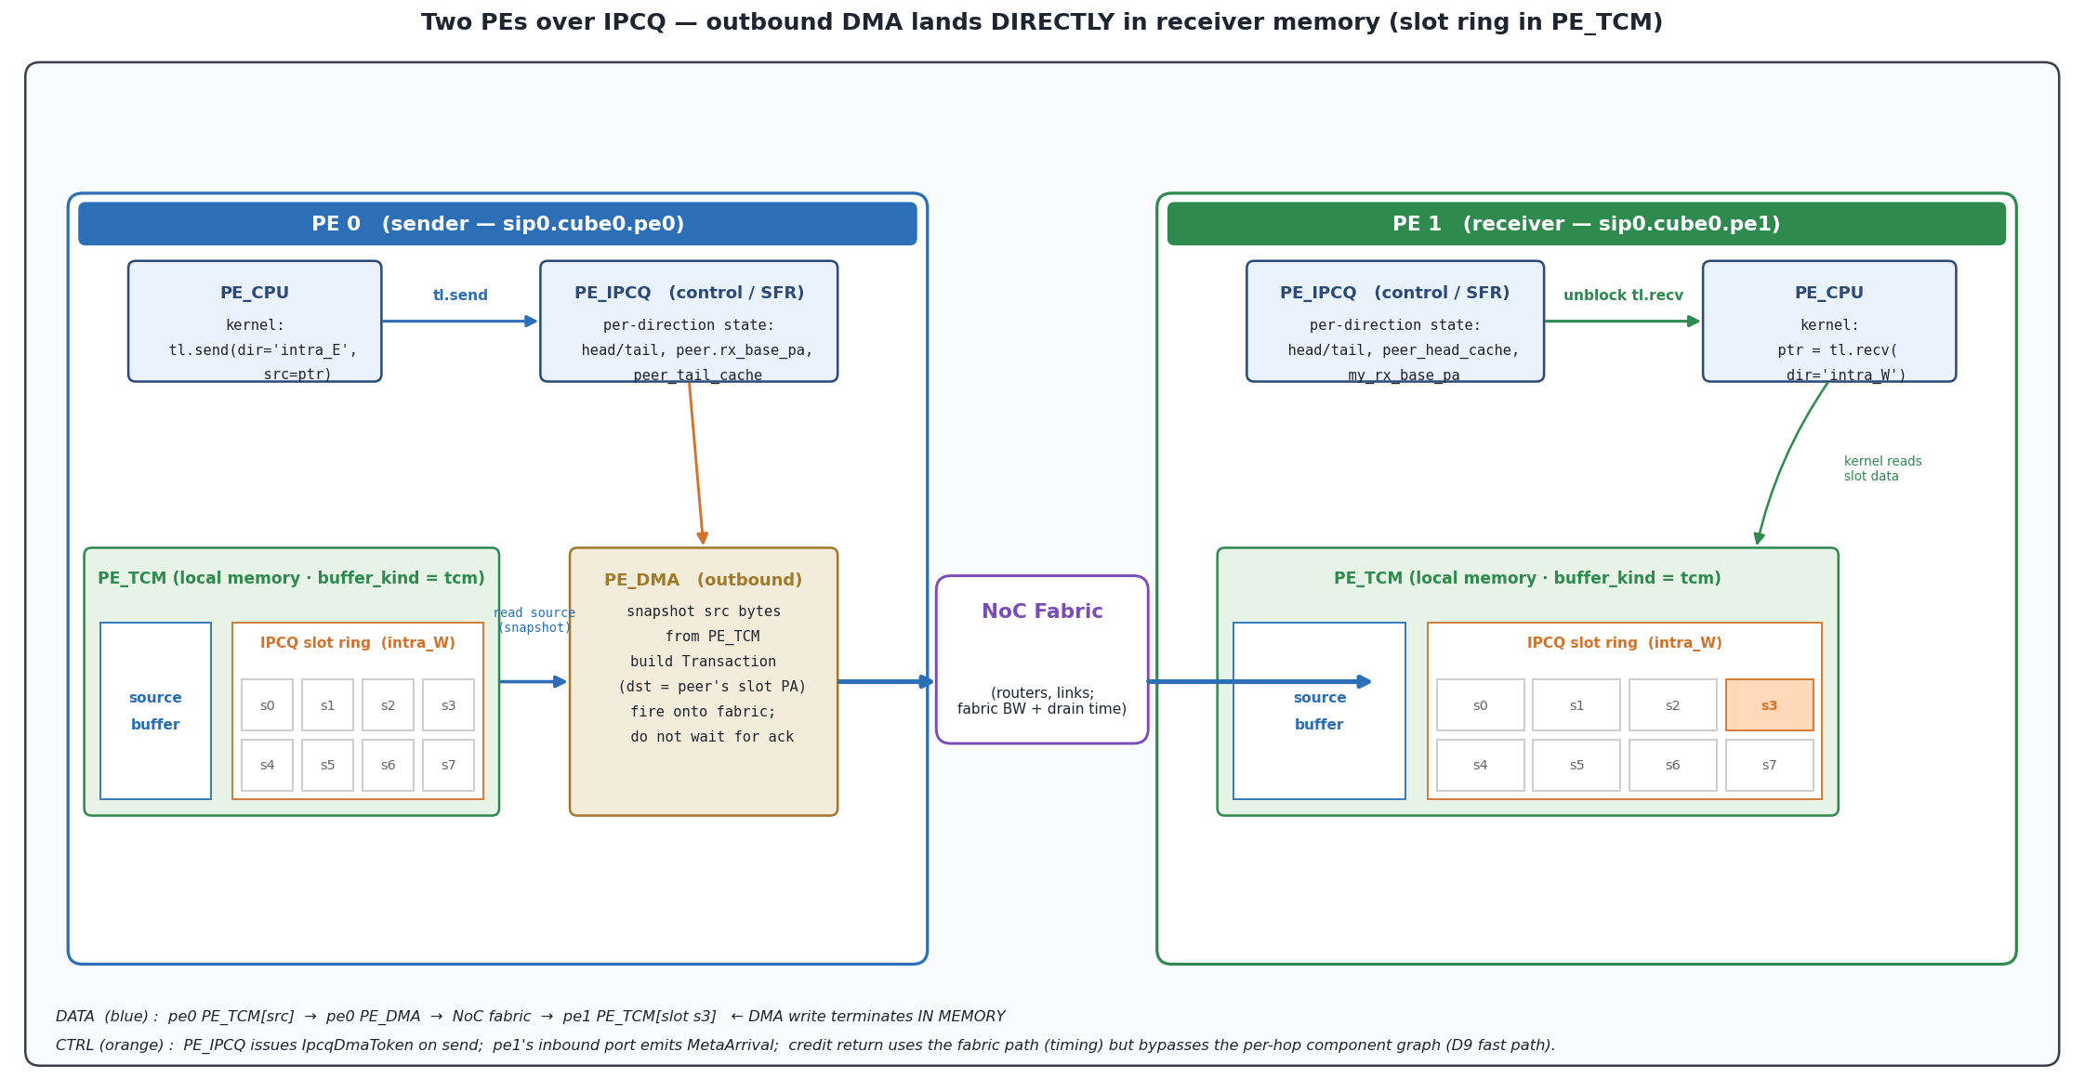
3. IPCQ: How Two PEs Communicate (DMA + Slot Memory)
• Sender pushes payload through PE_DMA → fabric → receiver IPCQ slot
• Slot memory (TCM/SRAM/HBM) charges a write on arrival, a read on consume
• Credit return rides the fabric path back (16 B packet, no slot-IO)
• This is the building block the multi-device allreduce composes
3 / 17

Slide 4
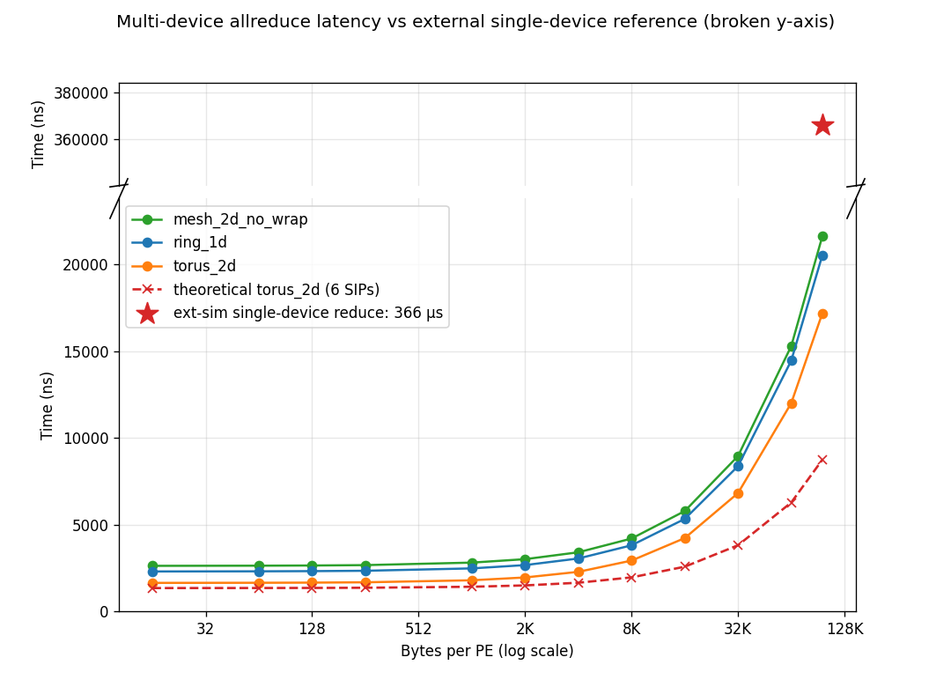
4. 6-Device Allreduce: Model vs Theoretical vs External Simulator
• Three SIP topologies (ring / torus / mesh) swept 16 B → 96 KB per PE
• Dashed red curve: hand-derived theoretical model for torus_2d (6 SIPs)
• Top panel (broken y-axis): single-device reduce on ext-sim ≈ 366 µs
• Our 6-device collective lands at ~17–22 µs — ~17× faster than ext-sim baseline
4 / 17

Slide 5
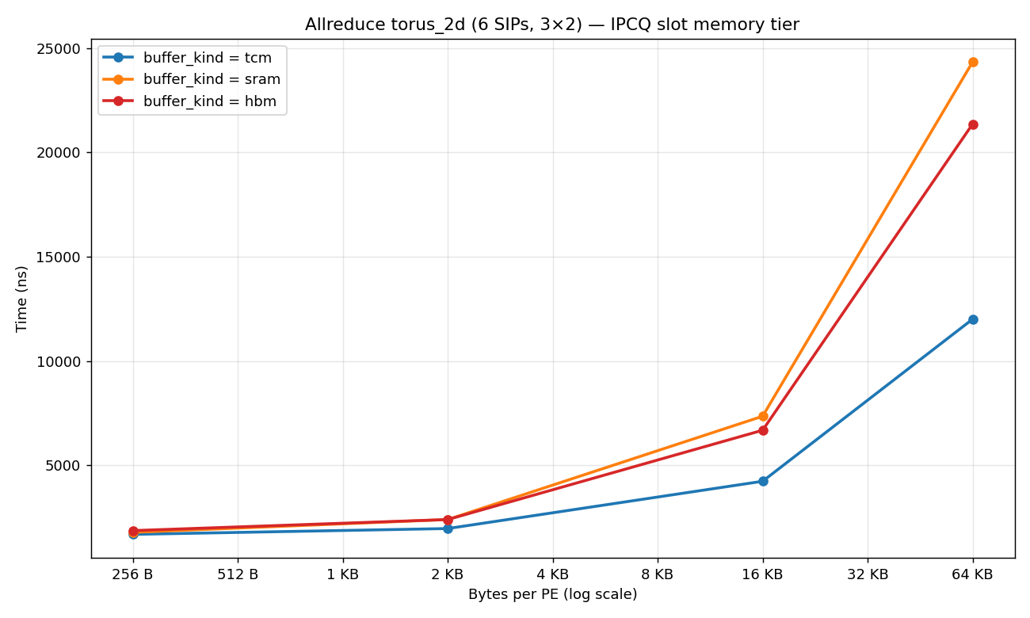
5. IPCQ Slot Memory: TCM vs SRAM vs HBM
• Same allreduce with slot memory swapped: TCM (per-PE local) / SRAM / HBM (cube-shared, behind router link)
• Cost = NoC drain + slot-IO + PE↔bank hop; only TCM skips the bank hop
• Topology link BWs set the order: SRAM bank link 128 GB/s is the narrowest in the system, HBM 256 GB/s
• At 64 KB / PE: TCM 12.0 µs < HBM 21.4 µs < SRAM 24.3 µs — SRAM is slowest because of its narrow bank link
5 / 17

Slide 6
6. PE_accelerator Data Path: Composite GEMM Pipeline
Vertical flow. HBM → DMA_in → TCM → GEMM Unit (FETCH + RegFile) → TCM → DMA_out → HBM. TCM sits on the side as the staging buffer between the DMA engines and the GEMM unit.
HBM (off-chip, 256 GB/s)
DMA_R
DMA_in
store to TCM
GEMM Unit
FETCH unit
FETCH (TCM → Reg)
TCM
(PE-local SRAM,
512 GB/s)
RegFile (A, B, C accumulator)
STORE (Reg → TCM, after last K)
↻ MAC accumulate (32 × 64 × 32 array)
DMA_out
read from TCM
DMA_W → HBM
6 / 17

Slide 7
7. PE_SCHEDULER: Plan Generation & Tile Dispatch
Sole dispatcher inside a PE. CompositeCmd is expanded into a TilePlan and fed tile-by-tile in FIFO order; each TileToken self-routes through the pipeline stages.
PE_CPU
PeInternalTxn(cmd)
PE_SCHEDULER
pe_dma
CompositeCmd → generate plan
pe_fetch_store
generate_plan(M, K, N)
→ ⌈M/32⌉ × ⌈K/64⌉ × ⌈N/32⌉ tiles
each tile:
[DMA_R, FETCH, GEMM,
STORE, DMA_W] stages
pe_gemm
pe_math
↻ TileToken.advance()
PipelineContext counts tiles
Key invariants: (1) FIFO across commands via the single feeder process — no inter-command tile interleaving. (2) TileToken carries its own plan; each engine reads token.current_stage, advances stage_idx, and forwards to the next stage's component. (3) PipelineContext.complete_tile() fires done_event on the last tile, unblocking PE_CPU.
7 / 17

Slide 8
8. matmul(32, 128, 32) — Composite GEMM Execution Sequence
load_ref assumption: A (32×128) is pre-loaded into TCM via tl.load before the kernel starts; only B is DMA_R'd per tile. FETCH can start as soon as the first DMA_R(B) finishes — A is already in TCM. Scheduler tile = 32×64×32 → 1·1·2 = 2 tiles. The PLAN-GEN/FEED block is the scheduler-side setup delay before the first DMA fires.
#1
#2
#3
#4
#5
#6
#7
#8
HBM
PLAN-GEN
+ FEED
(setup)
DMA_R B (tile 0)
4 KB ~16 ns
DMA_R B (tile 1)
4 KB ~16 ns
DMA_W out
2 KB ~8 ns
scheduler
TCM
[ A pinned via tl.load ]
FETCH (tile 0)
8 KB ~16 ns
FETCH (tile 1)
8 KB ~16 ns
STORE final
2 KB ~4 ns
RegFile
GEMM K=0 (accum)
— ~17 ns
GEMM K=1 (last)
— ~17 ns
Pipeline is balanced (DMA, FETCH, GEMM all ~16 ns/tile) — DMA engine carries only B, so per-tile DMA cost halves vs ref_ref. Wall = setup + head_latency + N_tiles·T_stage + final STORE+DMA_W.
pe_dma (HBM↔TCM)
pe_fetch_store (TCM↔RegFile)
pe_gemm (MAC compute)
8 / 17

Slide 9
9. matmul(32, 128, 128) — Pipeline Scaling & HBM Contention
── (m,n)=(0,0) full execution ──
── (0,1) starts ──
load_ref assumption: A (32×128) is pre-loaded into TCM via tl.load before the kernel starts; only B is DMA_R'd per tile. FETCH starts as soon as the corresponding B arrives — A is already in TCM. Scheduler tile = 32×64×32 → 1·4·2 = 8 tiles. PLAN-GEN/FEED block = scheduler-side setup delay before the first DMA.
#1
#2
#3
#4
#5
#6
#7
#8
#9
#10
#11
#12
HBM
PLAN-GEN
+ FEED
(setup)
HBM contention:
DMA_WRITE out + next DMA_READ A,B
compete for HBM BW
DMA_R B (0,0,0)
4 KB ~16 ns
DMA_R B (0,0,1)
4 KB ~16 ns
DMA_R B (0,1,0)
4 KB ~16 ns
DMA_W out₀₀
2 KB ~8 ns
DMA_R B (0,1,1)
4 KB ~16 ns
scheduler
TCM
[ A pinned via tl.load ]
FETCH (0,0,0)
8 KB ~16 ns
FETCH (0,0,1)
8 KB ~16 ns
STORE out₀₀
2 KB ~4 ns
FETCH (0,1,0)
8 KB ~16 ns
RegFile
GEMM K=0
— ~17 ns
GEMM K=1 last
— ~17 ns
GEMM K=0 (0,1)
— ~17 ns
HBM half-duplex caveat: real HBM channels can't read and write simultaneously. DMA_W out₀₀ competes for HBM bandwidth with DMA_R(B) of (0,1). Simulator currently models PE_DMA read / write as separate resources (full-duplex) — flag for revisit if half-duplex matters.
pe_dma (HBM↔TCM)
pe_fetch_store (TCM↔RegFile)
pe_gemm (MAC compute)
Pattern repeats for (m,n) = (0,1), (0,2), (0,3). DMA engine only carries B per tile, so the pipeline stays balanced — no DMA bottleneck like ref_ref.
9 / 17

Slide 10
10. Tiling Walkthrough: 32×128×32 — K-loop Only, No Inter-(m,n) Flush
Scheduler tile = 32×64×32 → 1·2·1 = 2 tiles. Only ONE (m,n) output → the K-loop accumulates entirely in RegFile, and STORE + DMA_W fire just once at the very end. No inter-(m,n) flush — DMA never has to drain mid-compute.
B (128 × 32)
C (32 × 32)
A (32 × 128)
B0
C0
=
A0
A1
·
K
↓
B1
← K (2 tiles) →
C = A0·B0 + A1·B1 (K-loop, 2 iterations — accumulator stays in RegFile)
Execution timeline — 1 (m,n) output, 0 inter-(m,n) flushes:
K=0 (accumulate into RegFile)
K=1 last
STORE + DMA_W (final drain)
✓ No inter-(m,n) flush
(only 1 output pair)
(m,n)=(0,0) → C (single output tile)
Why growing K helps: each (m,n) pair amortises its single STORE+DMA_W over K_tiles iterations of pure compute. With N=32 (one N-tile), there is no NEXT (m,n) pair, so no inter-pair flush at all. Pipeline efficiency is bottlenecked only by head latency and the final drain.
10 / 17

Slide 11
11. Tiling Walkthrough: 32×128×128 — K-loop & Inter-(m,n) Flushes
Scheduler tile = 32×64×32 → 1·2·4 = 8 tiles. A is split along K (2 tiles); B along K and N (2×4); C along N (4). For each (m,n) the K-loop accumulates in RegFile; STORE + DMA_W fire only on last K → 3 inter-(m,n) flushes between the 4 pairs.
B (128 × 128)
C (32 × 128)
A (32 × 128)
B00
B01
B02
B03
C0
C1
C2
C3
=
A0
A1
·
K
↓
B10
B11
B12
B13
← N (4 tiles) →
← K (2 tiles) →
← N (4 tiles) →
Cn = A0·B0n + A1·B1n (K-loop, 2 iters per (m,n) — accumulator stays in RegFile)
Execution timeline — 4 (m,n) outputs, 3 inter-(m,n) flushes:
K=0
(accum)
K=1 last
STORE +
DMA_W
FLUSH
(DMA_W
vs DMA_R)
K=0
(accum)
K=1 last
STORE +
DMA_W
FLUSH
(DMA_W
vs DMA_R)
K=0
(accum)
K=1 last
STORE +
DMA_W
FLUSH
(DMA_W
vs DMA_R)
K=0
(accum)
K=1 last
STORE +
DMA_W
(0,0) → C0
(0,1) → C1
(0,2) → C2
(0,3) → C3
Why flushes hurt: at every (m,n) boundary, DMA_W of Cn competes with DMA_R of the next pair for the cube-shared HBM channel. Inter-flush count = (M_tiles · N_tiles − 1) — for 32×128×128 that's 1·4−1 = 3 flushes. Bigger N → more flushes; bigger K alone (with small N) → none.
11 / 17

Slide 12
12. GEMM Sweep — Stage Wall-Clock (load_ref)
Variant: load_ref | Per-stage engine wall-clock (linear) — DMA in / Fetch / GEMM / DMA out per shape. Tile size 32×64×32.
1056
Stages (per bar):
DMA in
845
Fetch
GEMM
DMA out
634
ns
422
211
0
M=K=N=32
M=32
K=64
N=32
M=32
K=128
N=32
M=32
K=128
N=128
M=32
K=3072
N=32
M=8
K=128
N=128
M=128
K=8
N=128
1 tiles
1 tiles
2 tiles
8 tiles
48 tiles
8 tiles
16 tiles
↑ under-tile
↑ under-tile
↑ under-tile
12 / 17
Bars = engine wall-clock interval (max t_end − min t_start, merged overlaps). Strips queue-wait double-counting.

Slide 13
13. Why DMA Isn't Local: Cube-Shared HBM Path
DMA reads cross the cube fabric — HBM_CTRL is one per cube (NOT per PE). All 8 PEs serialize at the controller's single channel resource. Even one active PE pays the round-trip on every K-tile miss.
CUBE (8 PEs share HBM)
PE0
PE1
PE2
PE3
ROUTER
MESH
256 GB/s
per link
TCM (local)
512 GB/s
TCM (local)
512 GB/s
TCM (local)
512 GB/s
TCM (local)
512 GB/s
HBM BANKS
(per-cube)
256 GB/s
aggregated
HBM_CTRL
(1 per cube)
read channel
cap = 1
PE4
PE5
PE6
PE7
256 GB/s
TCM (local)
512 GB/s
TCM (local)
512 GB/s
TCM (local)
512 GB/s
TCM (local)
512 GB/s
BOTTLENECK
TCM is per-PE local → fetch/store don't contend.
HBM_CTRL is cube-shared → every DMA serializes on cap=1 channel.
Per-op DMA cost grows with #in-flight ops even on 1 PE.
load_ref/load_load pin operands → 1 HBM trip instead of per K-tile.
13 / 17

Slide 14
14. Formula vs Measured Useful Eff (load_ref) — sim validates model
Four series per shape:
• GEMM util (formula, green): useful_FLOPs ÷ (tile_FLOPs × tile_count_expected) — structural shape-vs-tile ceiling.
• GEMM util (measured, mint): useful_FLOPs ÷ (tile_FLOPs × GEMM_record_count) — uses the actual GEMM ops the simulator ran. Should equal formula → validates plan execution.
• Formula useful eff (amber): GEMM_util × ideal pipeline efficiency.
• Measured useful eff (blue): (useful_FLOPs ÷ composite_window_ns) ÷ peak — composite_window_ns covers only the tl.composite pipeline (excludes upfront tl.load).
110
Variants (per bar):
100% peak
GEMM util % (formula)
88
GEMM util % (measured, op_log)
Formula useful eff %
Measured useful eff %
66
%
44
22
0
M=K=N=32
M=32
K=64
N=32
M=32
K=128
N=32
M=32
K=128
N=128
M=32
K=3072
N=32
M=8
K=128
N=128
M=128
K=8
N=128
1 tiles
1 tiles
2 tiles
8 tiles
48 tiles
8 tiles
16 tiles
↑ under-tile
↑ under-tile
↑ under-tile
14 / 17
Reading: GEMM util F = GEMM util M → simulator ran the expected tile plan. Measured eff uses composite-only window (excludes upfront tl.load), so it isolates pipeline efficiency. Variant: load_ref.

Slide 15
15. Pipeline Efficiency Walkthrough — 32×128×128 (with inter flushes)
Example: M=N=32, K=128, N-output=128 → 8 tiles in 4 output groups of 2 K-tiles each. T_stage = 16 ns/tile, pipeline depth D = 3.
DMA_R
HBM → TCM
FETCH
TCM → Reg
GEMM
MAC array
each stage = 16 ns/tile → head latency = (D−1) × T_stage = 32 ns
(m=0,n=0) K-loop
(m=0,n=1) K-loop
(m=0,n=2) K-loop
(m=0,n=3) K-loop
head
32 ns
GEMM
T1
GEMM
T2
flush
GEMM
T3
GEMM
T4
flush
GEMM
T5
GEMM
T6
flush
GEMM
T7
GEMM
T8
tail
(excluded
from wall)
wall = 184 ns
wall = head + N_tiles × T_stage + (N_mn − 1) × T_dma_w = 32 + 8×16 + 3×8 = 184 ns
GEMM useful time = N_tiles × T_stage × GEMM_util = 8×16×100 % = 128 ns
Useful efficiency = 128 / 184 = 69.6 %
Overhead = head (pipeline fill) + inter-(m,n) flushes. Bigger K (more amortization) and smaller N (fewer groups) both raise the efficiency.
15 / 17

Slide 16
16. Pipeline Efficiency Walkthrough — 32×3072×32 (large K, no flushes)
Example: M=N=32, K=3072 → 48 tiles, N_mn = M_tiles × N_tiles = 1 × 1 = 1 → no inter-(m,n) DMA_W flushes. Long K-loop amortizes the head.
DMA_R
HBM → TCM
FETCH
TCM → Reg
GEMM
MAC array
each stage = 16 ns/tile → head latency = (D−1) × T_stage = 32 ns
(m=0,n=0) K-loop — all 48 tiles in one group, NO inter flushes
head
32 ns
GEMM
T1
GEMM
T2
GEMM
T3
GEMM
T4
. . . 42 more GEMM tiles . . .
GEMM
T47
GEMM
T48
tail
(excluded
from wall)
wall = 800 ns
wall = head + N_tiles × T_stage + (N_mn − 1) × T_dma_w = 32 + 48×16 + 0 = 800 ns
GEMM useful time = 48×16×100 % = 768 ns
Useful efficiency = 768 / 800 = 96.0 %
Long K-loop, one output group → head amortized over 48 GEMM tiles, no flush penalty. Approaches 100 % as K grows.
16 / 17

Slide 17
17. Useful Pipelined Efficiency (ideal pipeline × GEMM util)
Ideal pipelined model — assumes non-blocking tl.load + multi-channel HBM so DMA, FETCH and GEMM all run at T_stage = 16 ns/tile.
wall = head_latency + N_tiles × T_stage + Σ inter-(m,n) DMA_W
head_latency = (D−1) × T_stage = 32 ns (pipeline fill, D = 3 stages).
inter DMA_W = (N_mn − 1) × 8 ns (final flush is tail — excluded).
useful eff = (N_tiles × T_stage × GEMM_util) / wall — MAC time producing real output, not padded zeros.
Input shape | GEMM util % | Useful eff %
32×32×32 (under-tile) | 50.0 % | 16.7 %
32×64×32 | 100.0 % | 33.3 %
32×128×32 | 100.0 % | 50.0 %
32×128×128 | 100.0 % | 69.6 %
32×3072×32 | 100.0 % | 96.0 %
8×128×128 (under-tile) | 25.0 % | 17.4 %
128×8×128 (under-tile) | 12.5 % | 7.8 %
What the model could achieve with non-blocking tl.load + multi-channel HBM (A streams tile-by-tile, no upfront serial). Today's simulator caps at ~50 % for tall-skinny K because tl.load is whole-operand blocking and the cube has a single HBM channel.
17 / 17

